Slide 1
Preparation and administration of the Platelet Rich Plasma (PRP)

Slide 2
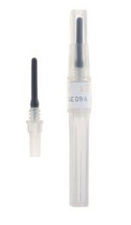
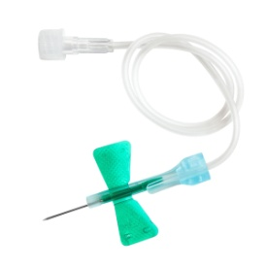
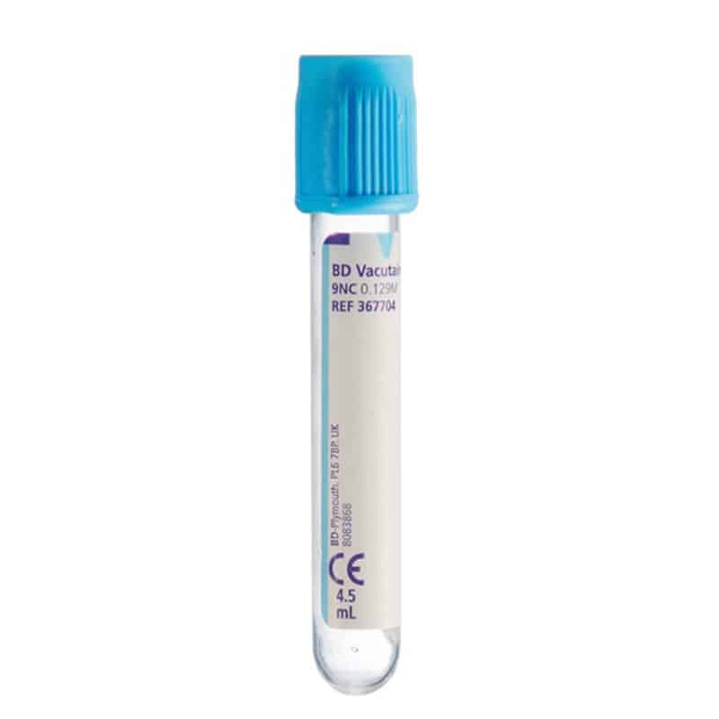
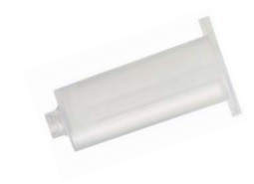
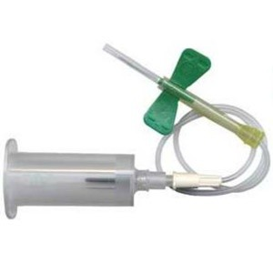
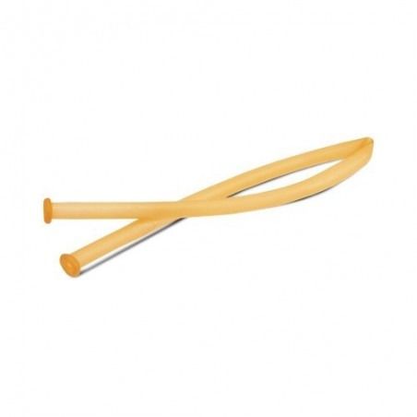
Needed for collection
5 ml test tube: contains 0.5 ml of sodium citrate; 9NC 0,129M
Butterfly needle, adapter and shirt
Tourniquet

Slide 3
Preparation for blood collection
Wash hands and arms up to the elbow thoroughly with soap. The nurse will disinfect the specific area before inserting the needle.
Warning: at the end of filling, each test tube should be slowly inverted, several times, to ensure that the anticoagulant is distributed evenly.

Slide 4
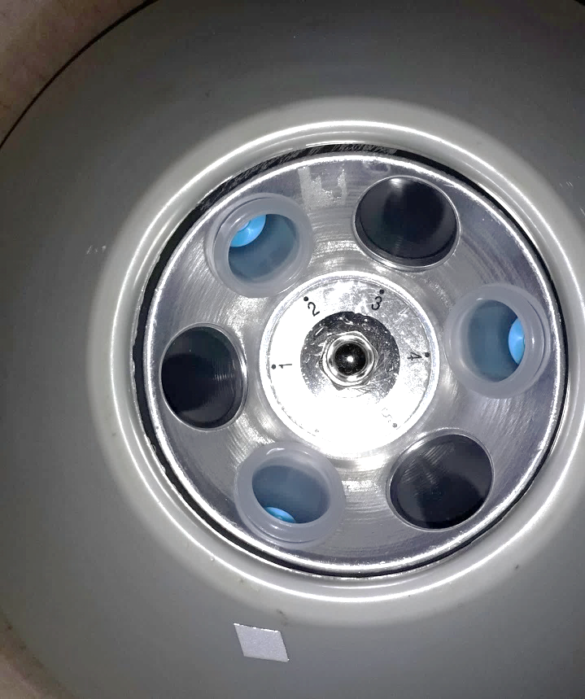
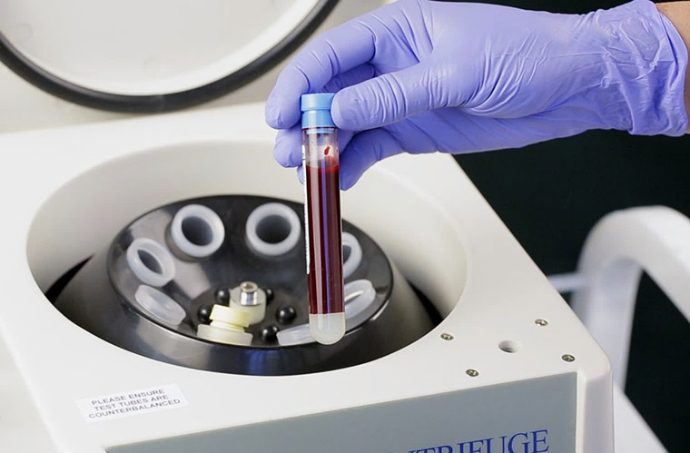
After taking the sample, place the three tubes in the centrifuge. Having six slots in the centrifuge, the tubes must be positioned with an empty space between one and the other. This is important to balance the weight of the rotor and have an optimal centrifugation.

Slide 5
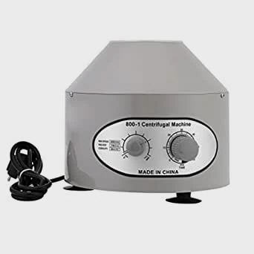
Use a digital timer (the phone timer for example), set the rpm knob to 2.000 rpm and spin for 7 minutes

Slide 6
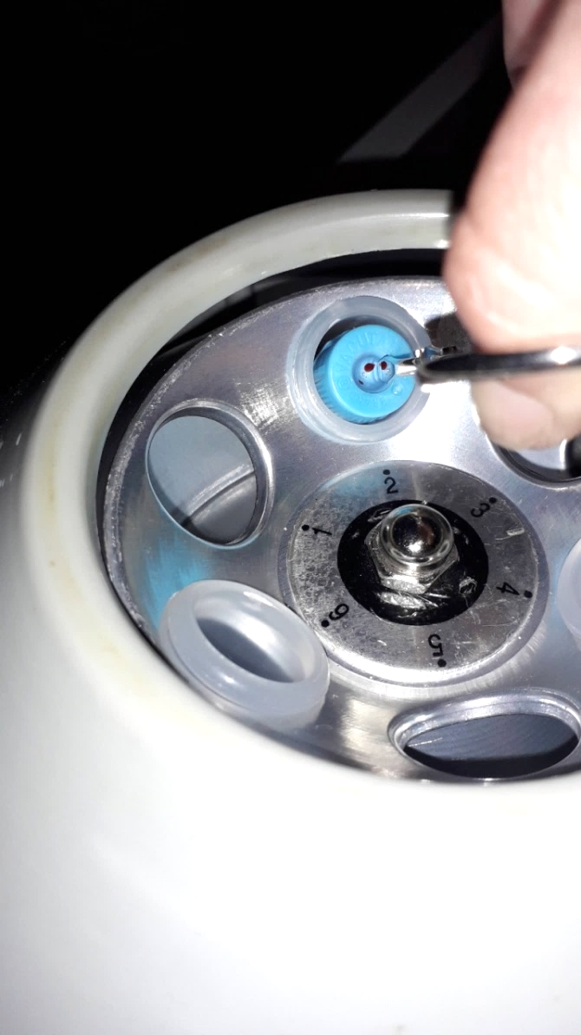
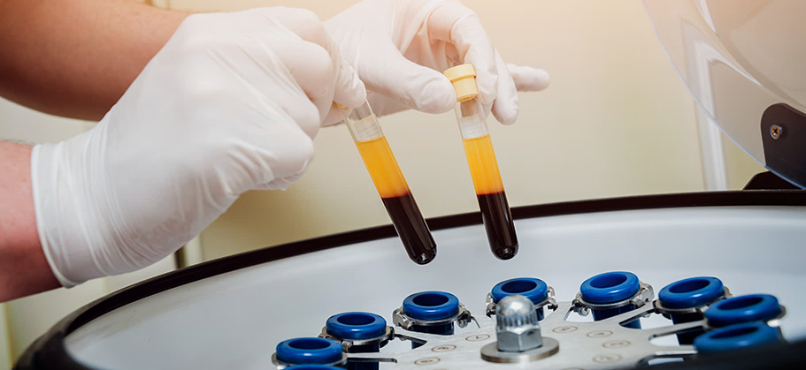
Remove the test tubes very carefully using tweezers.

Slide 7
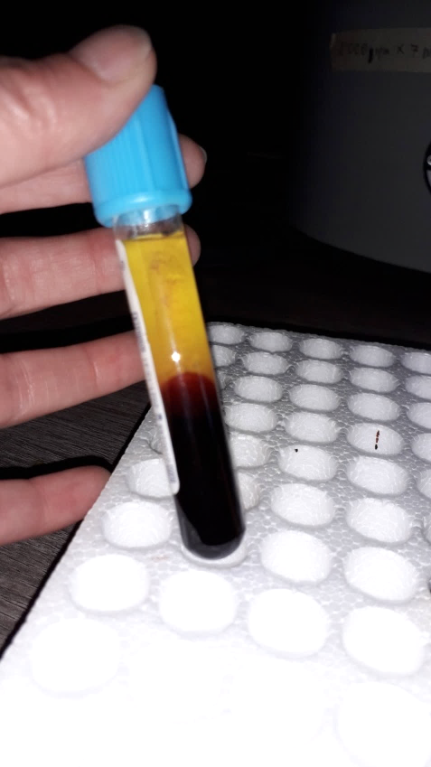
- Place the test tubes upright.
- Wear a surgical mask to avoid breathing over the test tube
- To aspirate the plasma it is necessary to remove the cap of the tube, making sure that when doing so, the tube does not undergo sudden movements, to avoid the movement of the liquid inside it (otherwise the red blood cells end up in the plasma).

Slide 8
Aspirate the plasma by bringing the needle close to the limit of the two phases, excluding about 20% of the plasma that is in the upper part of the tube (see next slide photographs).
(To view the video, it must be downloaded to your computer)

Slide 9
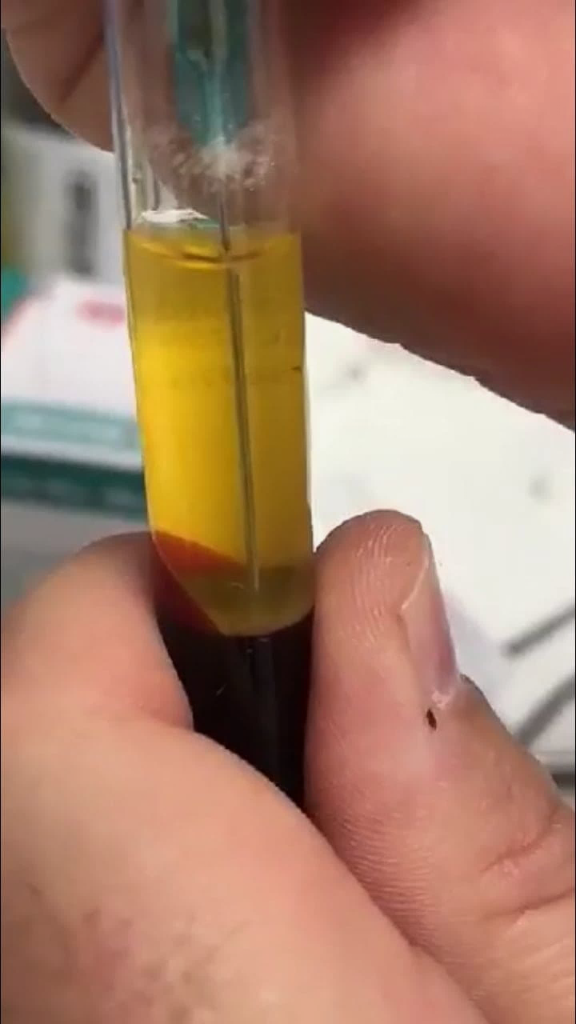
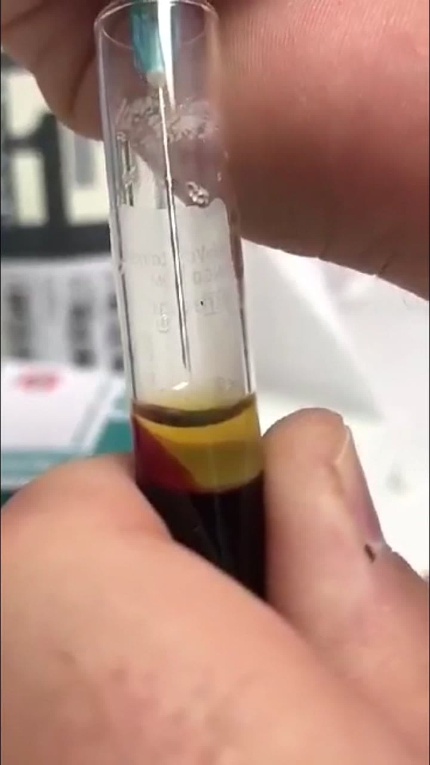
In the photo on the right 20% (approximately) of the plasma to be left in the test tube.

Slide 10
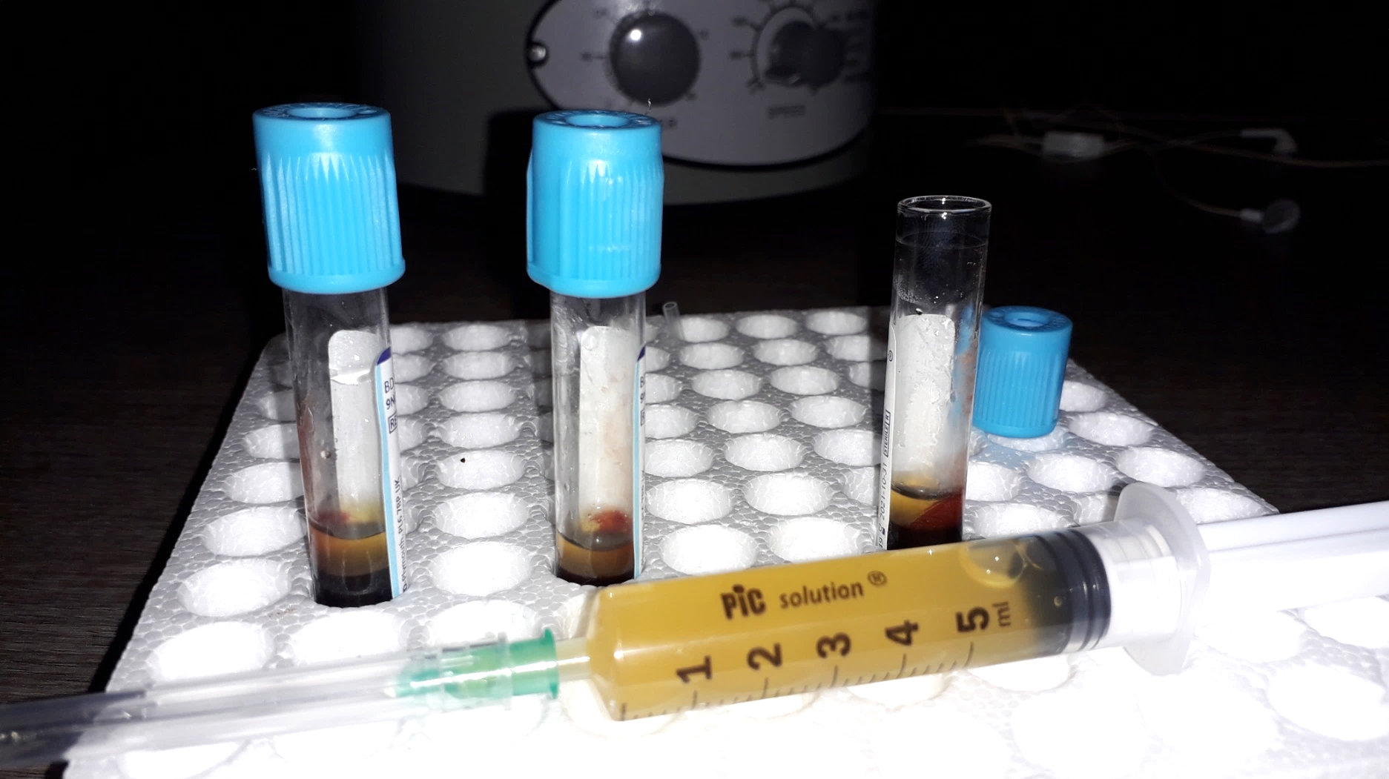
Replace the syringe needle with the one used for insulin or heparin: 0.40x12.7mm 27Gx1/2” (if smaller is even better).

Slide 11
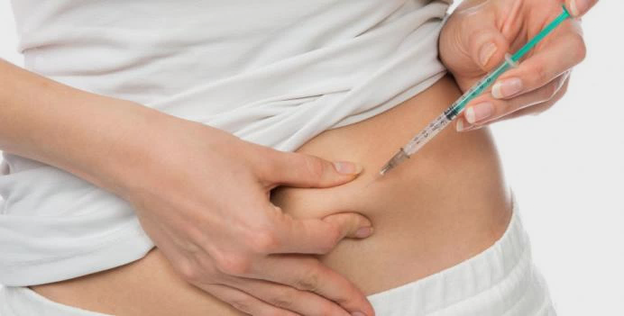
Disinfect an area of the belly far from the navel and proceed very slowly (about 10 minutes) with subcutaneous administration.
Due to the large volume (from 3 to 5ml) distribution, by injection, in two or more different areas of the abdomen is recommended.

Slide 12
It is of fundamental importance to respect hygiene and cleanliness, both in the room where the preparation takes place, and during all the steps of preparation and administration.

Slide 13
It is recommended to do one treatment (with three test tubes) per week for six weeks, then, depending on the results and the pathology:
- continue with one treatment per week for a few months
- the treatments are reduced: one per month.

Slide 14
Thanks for your attention.
With Love
Blue

